Slide 1
Microsoft Power Virtual Agents

Slide 2


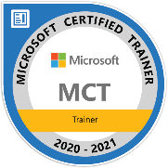
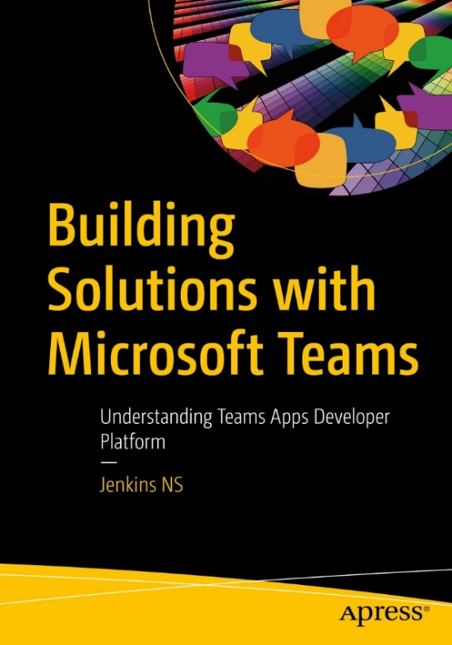


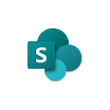
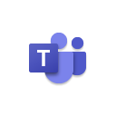




Jenkins NS
Modern Workplace Solution Architect | Consultant
18+ Years of experience
Power Platform, Microsoft Teams, and SPFx Specialist
International Speaker | Author | Trainer
SPS/M365 Bangalore Organizer
aOS Ambassador
jenkinsns@gmail.com
in/jenkinsns
@jenkinsns
http://www.jenkinsblogs.com
https://www.youtube.com/user/jenkinsns

Slide 3
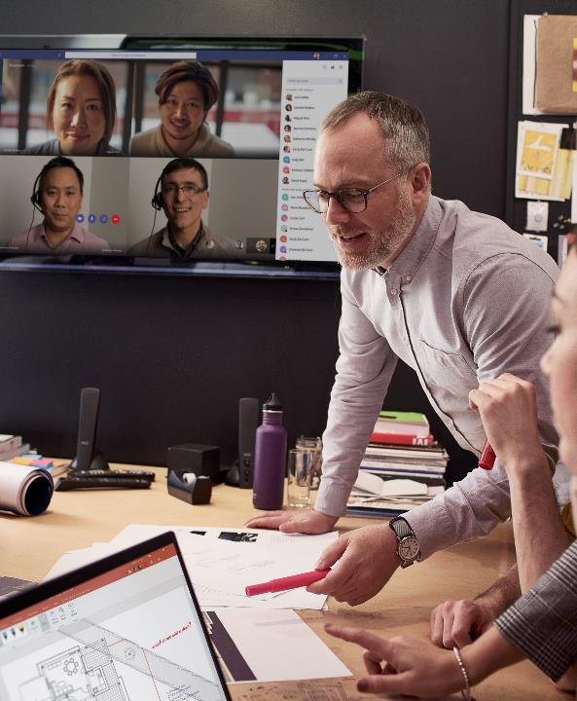
Agenda
Introduction
A Robust Virtual Agent Platform
Converse everywhere
Easily make your bots better
Create personalized customer experiences
Transfer to a human agent
Built on Power Platform & Azure Bot Service
Extend your bot capabilities with Azure Bot Service
Demo
Create and deploy a Power Virtual Agents bot

Slide 4

Empower your people to drive more business value through easy to create natural, conversational AI
Power Virtual Agents
Intelligent virtual agents

Slide 5
Power Virtual Agents is Designed For Everyone The chatbot service that enhances everyone’s experience
Your Customers
Subject Matter Experts
IT Admin/Dev

Slide 6
A Robust Virtual Agent Platform
Easily build powerful conversations
Create personalized customer experiences
Limitless extensibility with Bot Framework Skills
^{preview}

Slide 7
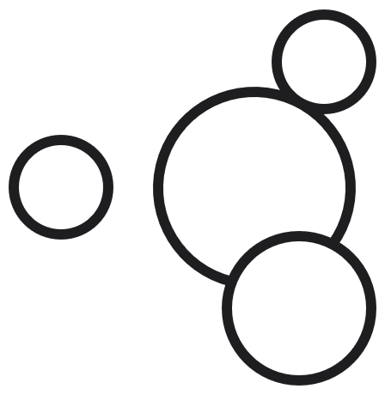

Microsoft Power Platform
The low-code platform that spans Office 365, Azure, Dynamics 365, and standalone applications
Innovation anywhere. Unlocks value everywhere.
Power BI
Business analytics
Power Apps
Application development
Power Automate
Process automation
Power Virtual Agents
Intelligent virtual agents
Data connectors
Portals
AI Builder
Common Data Service

Slide 8
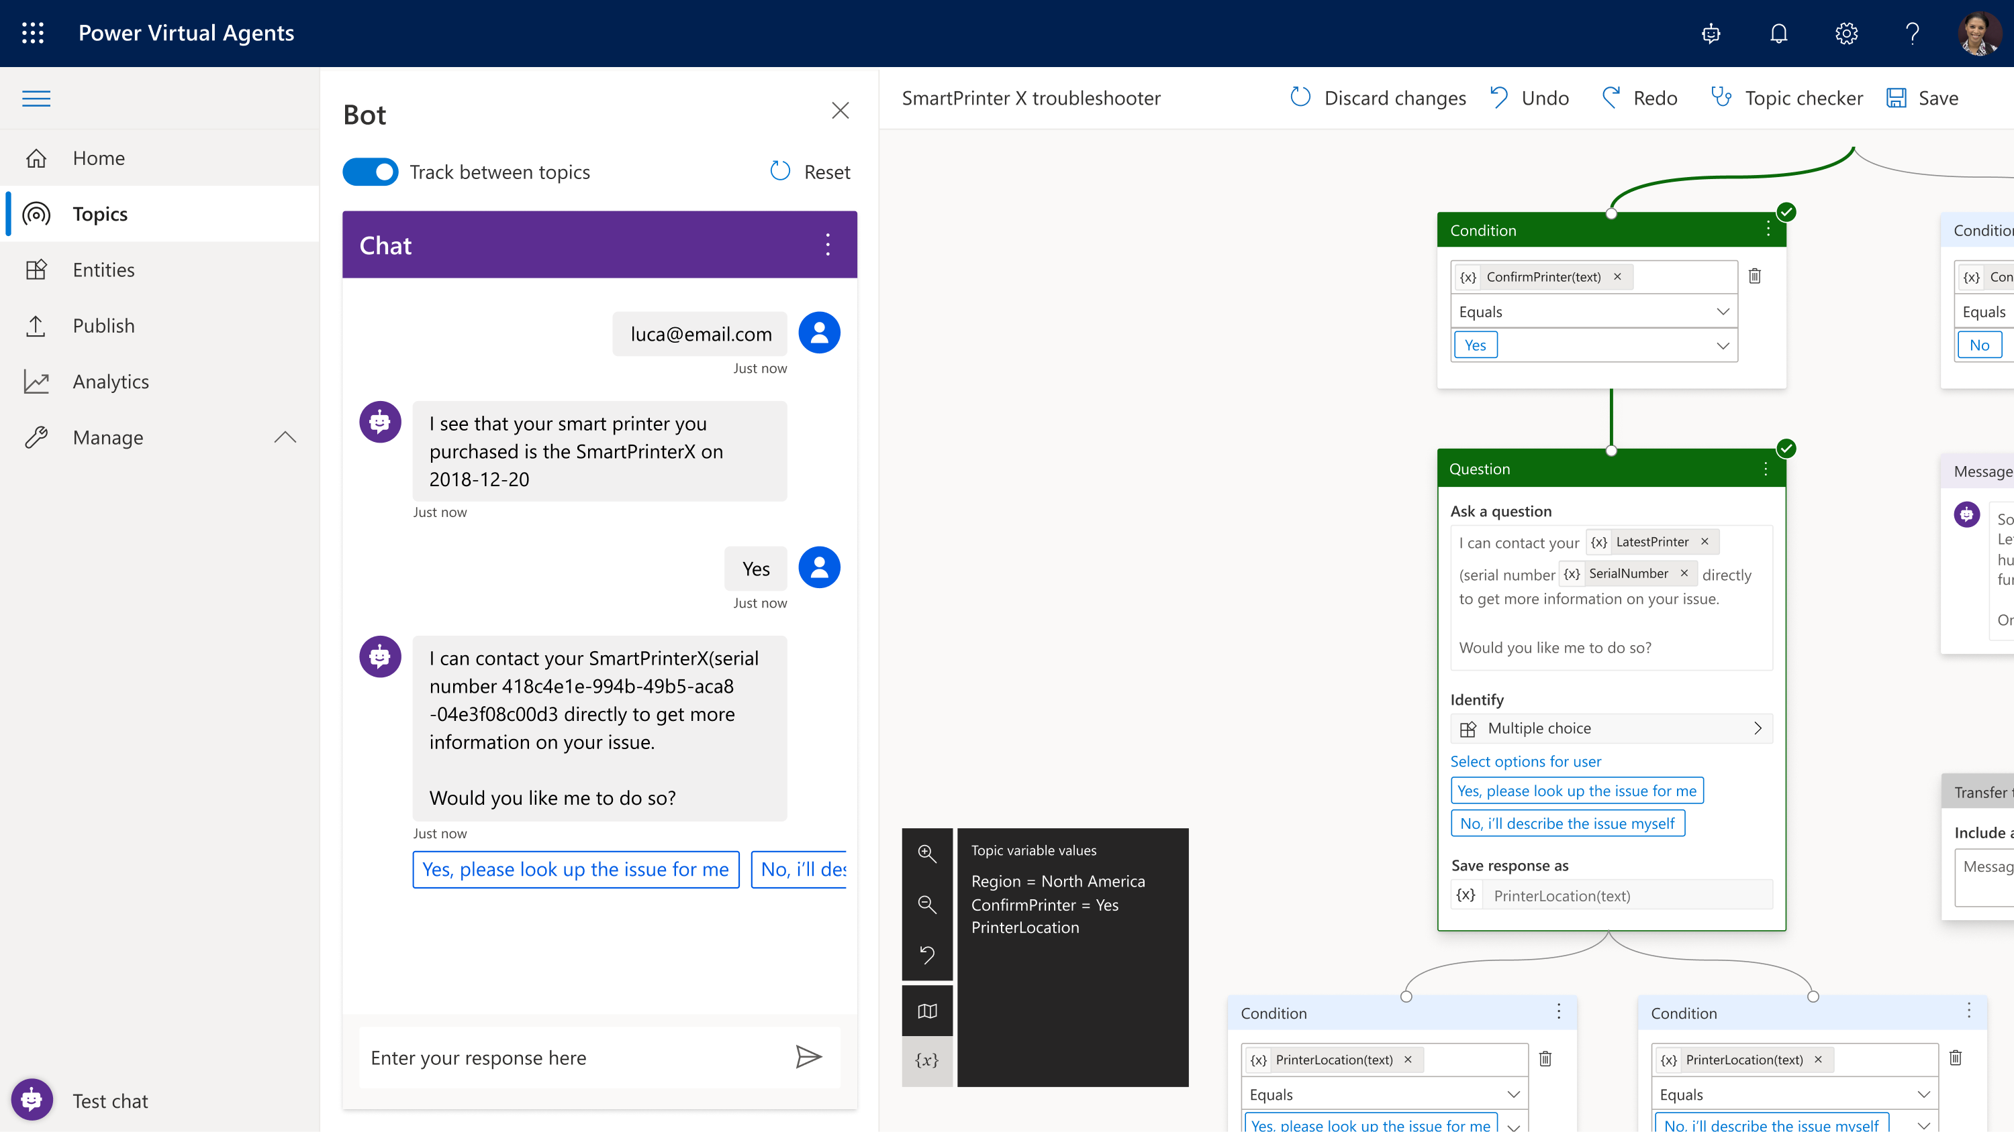
Making Bots Easy
Simple, graphical bot creation
Easily test and maintain bots through a simple, easy to use graphical interface
Extract information from user responses
Recognize, extract, and act on common entities in a user’s responses. For example, colors, currencies, ages, dates and times. Or create your own custom entities, e.g. model numbers
Remember user responses
Store user information for use later in variables and use them to branch or create personalized conversations

Slide 9
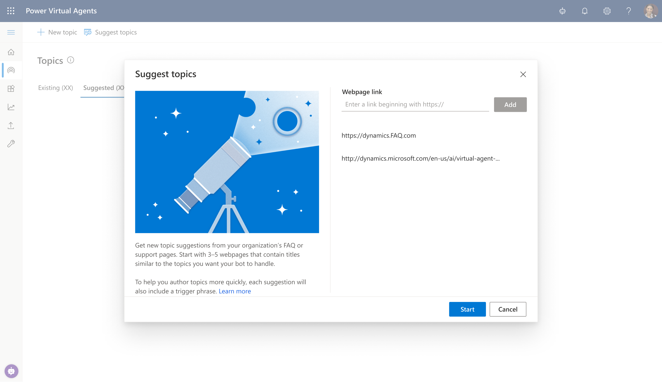
Get Started Quickly
Learn from your website
Just point the bot to your website, and it will extract common questions, FAQs and pre-build topics for you – so you can be up and running in minutes - out of the box.

Slide 10
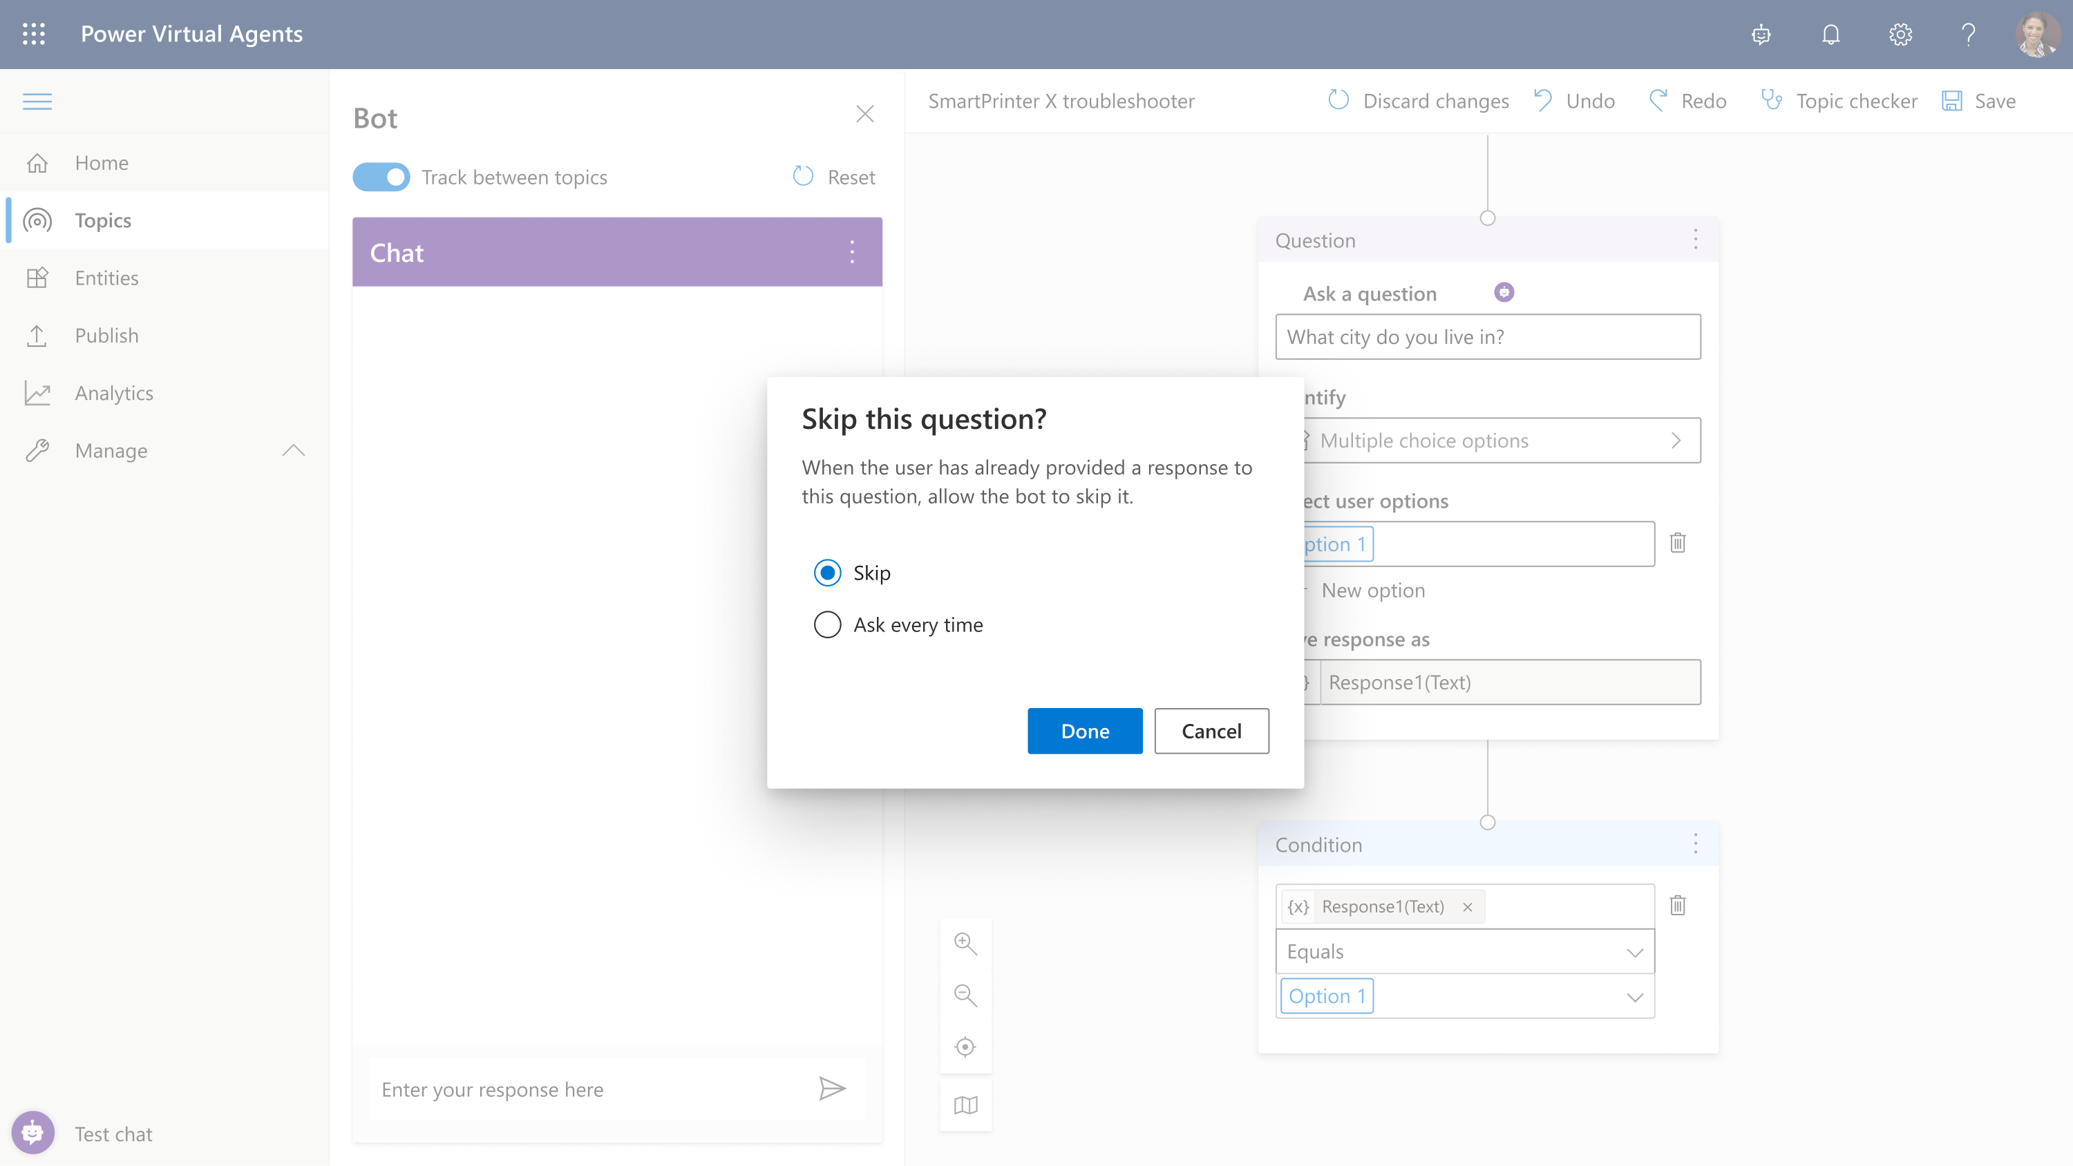
Avoid Repetitive Conversations
Slot-filling capabilities
The bot doesn’t follow the dialog script blindly. It intelligently uses all the information it has to decide when to ask a question and when to skip them.
For example, if the user provided information earlier in the conversation, the bot will remember it and skip asking about it again

Slide 11
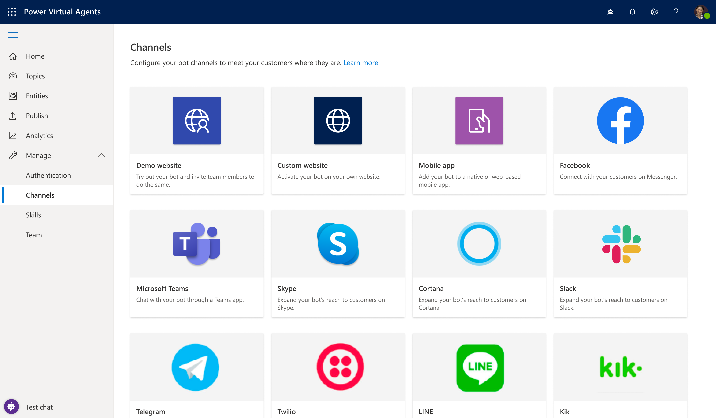
Converse everywhere
Use bots wherever you need them:
Configure and deploy to multiple channels
Easily embed your bot wherever your organization engages with customers: websites, mobile apps, Facebook, Teams or any of the dozens of channels supported by Azure Bot Service
Deploy to demo sites with a single click
Test and gain feedback by deploying your bot to a demo website and sharing it internally with colleagues, before embedding it to your own website when ready

Slide 12
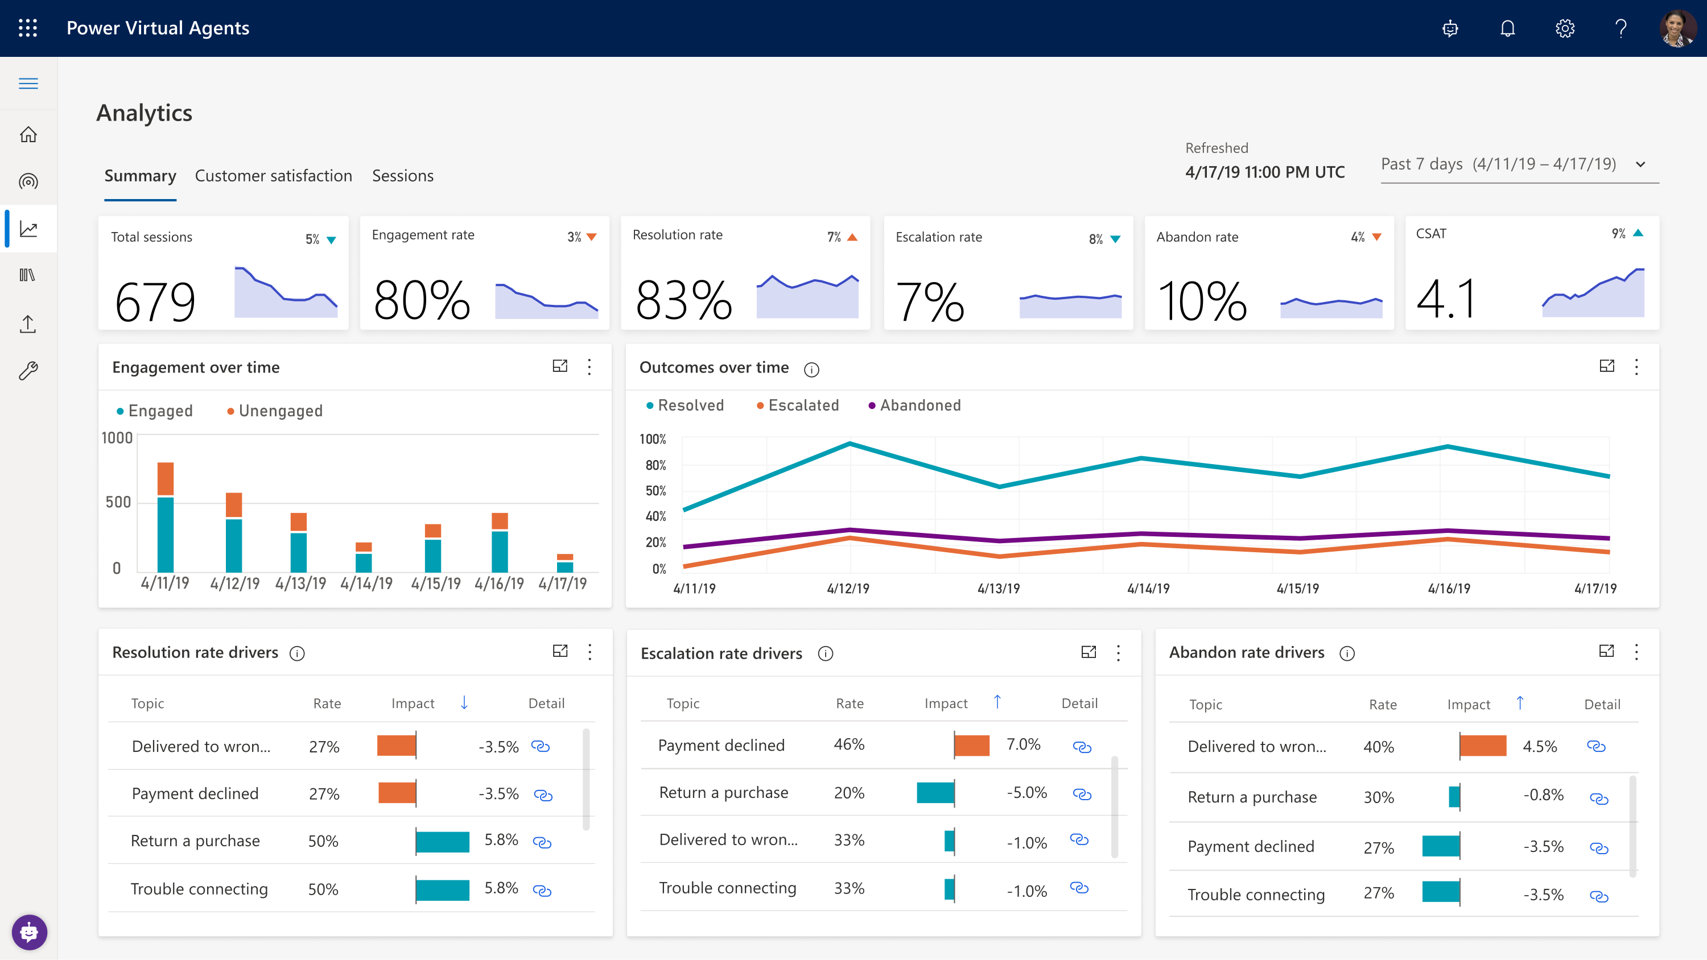
Easily make your bots better
Easily see what’s working – and what to improve
Analyze bot / customer conversations to better understand how specific topics are performing, what’s impacting your CSAT, and identify where there is room for improvement
Quickly figure out what to build next
Easily see which conversations are going to human agents and determine which topics to teach your bot next

Slide 13
Easily build powerful conversations
Learning 1:
Easy to create, build, test and deploy a virtual agent. You can focus on content.
Learning 2
Advanced AI capabilities help the chatbot become smarter and create a great customer experience.
Learning 3:
Extend your chatbot by leveraging Power Automate and 100s of pre-build connectors.

Slide 14
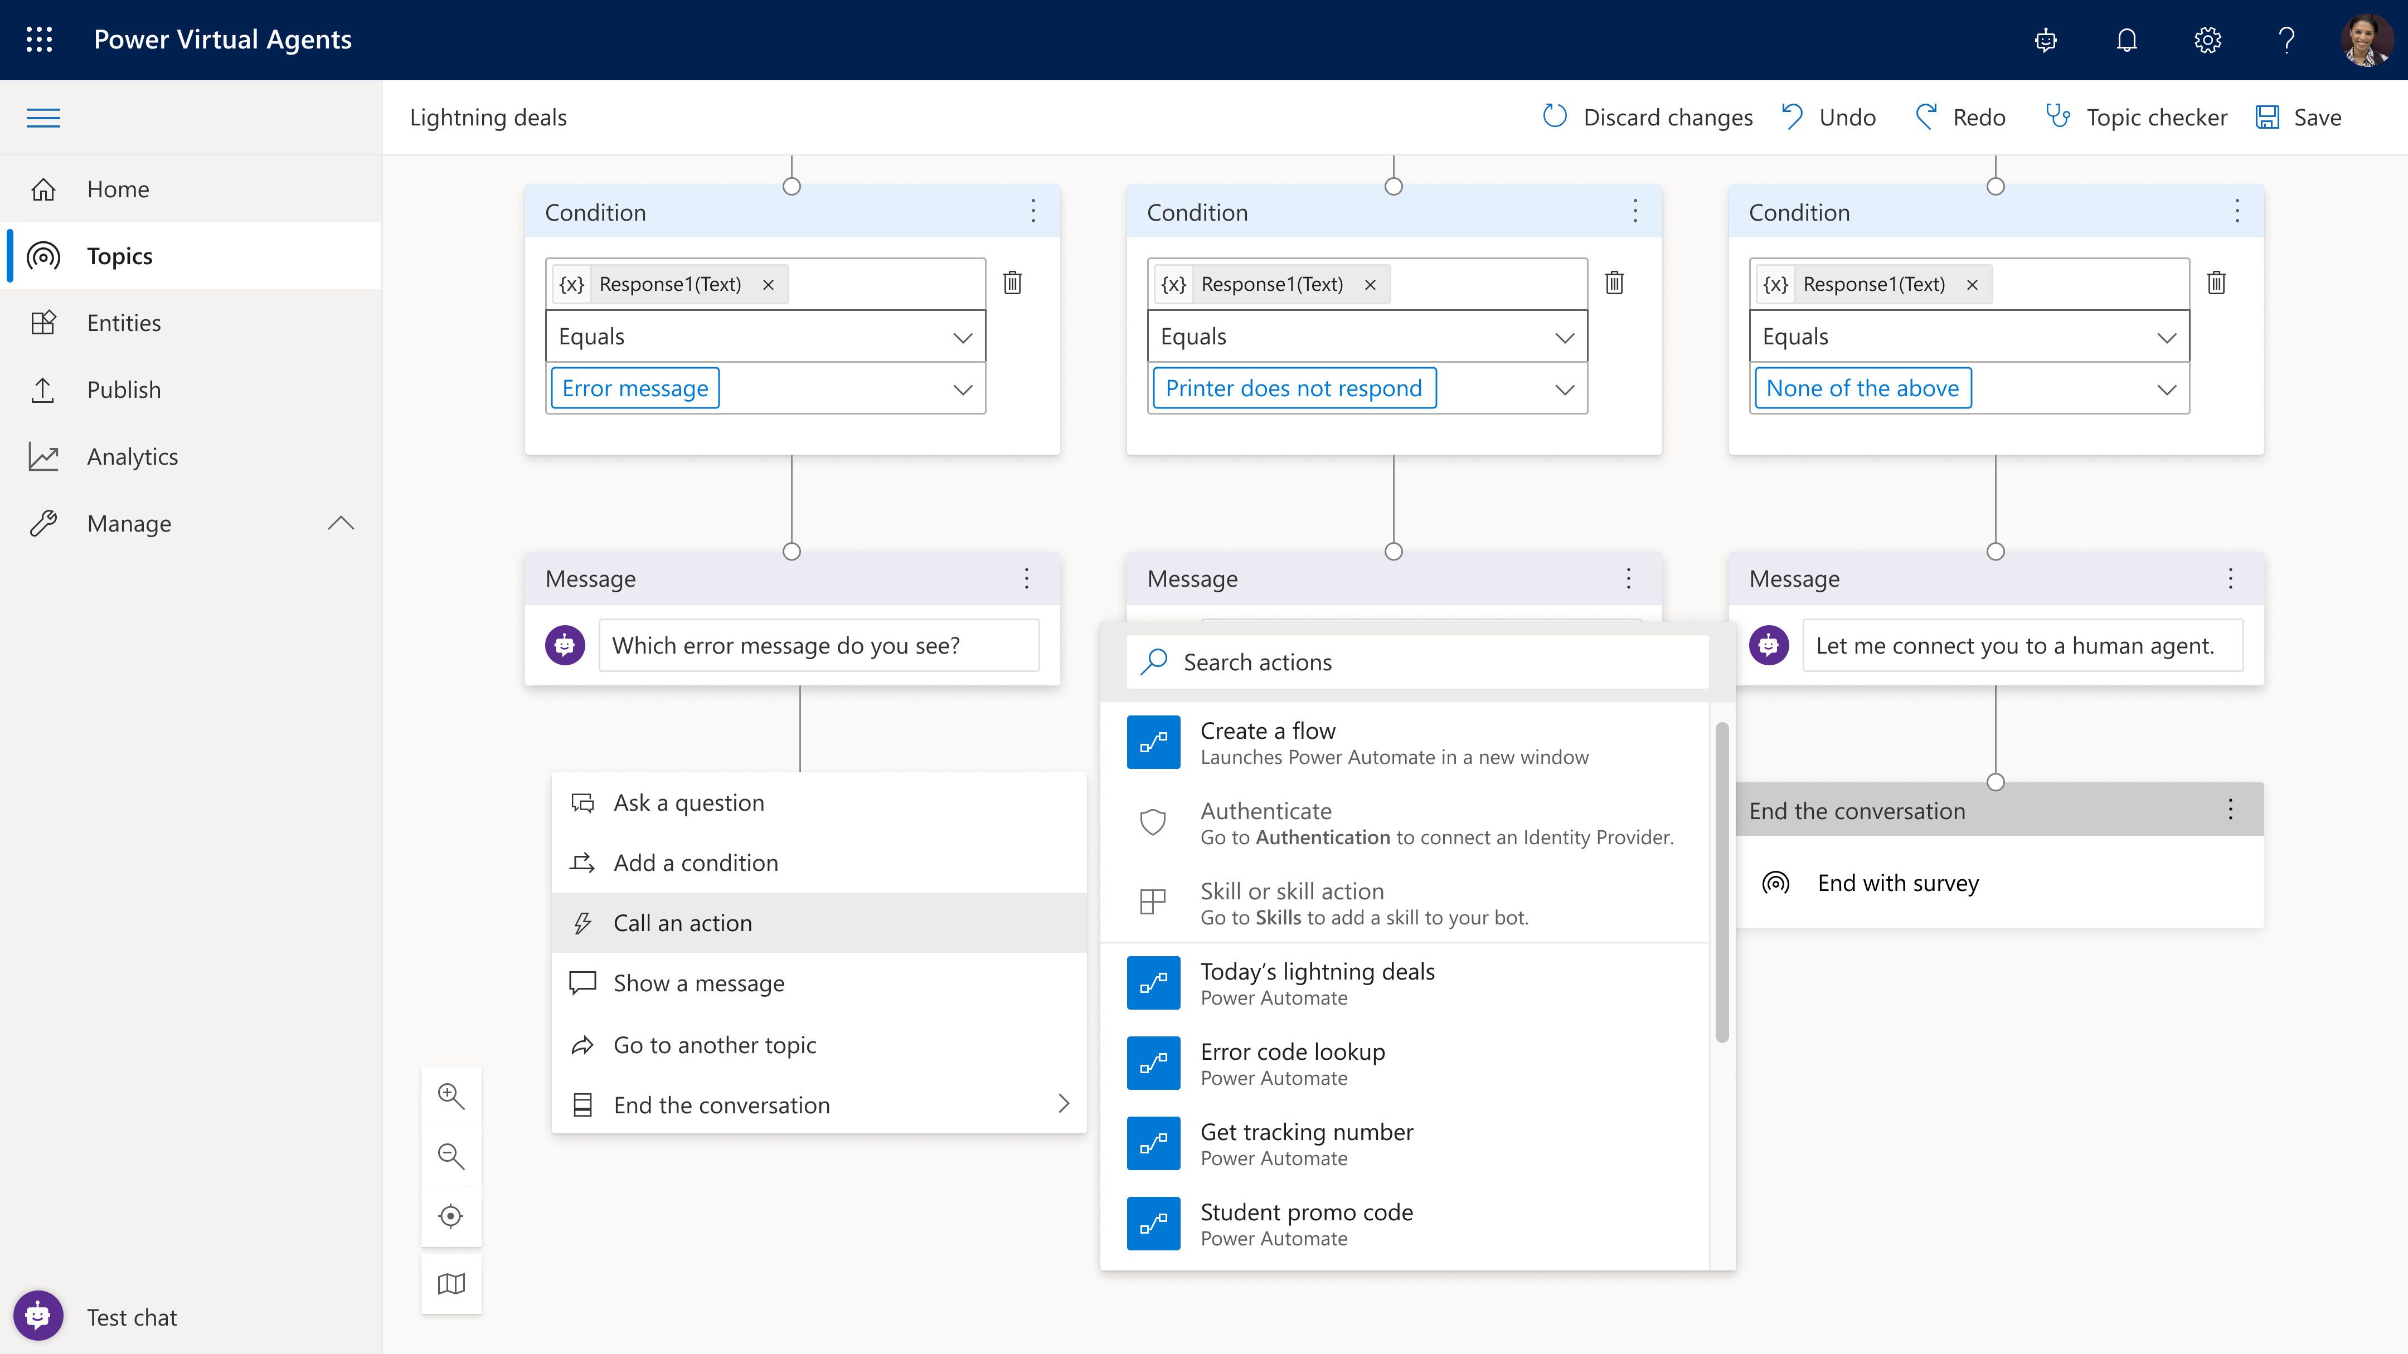
Create personalized customer experiences
Extend bot conversational capabilities with Power Automate.
Enable your bot to act on behalf of your customer
Enable actions/access data from back-end systems
Recognize your customer
Allow the bot to access the user’s information and take action on their behalf

Slide 15
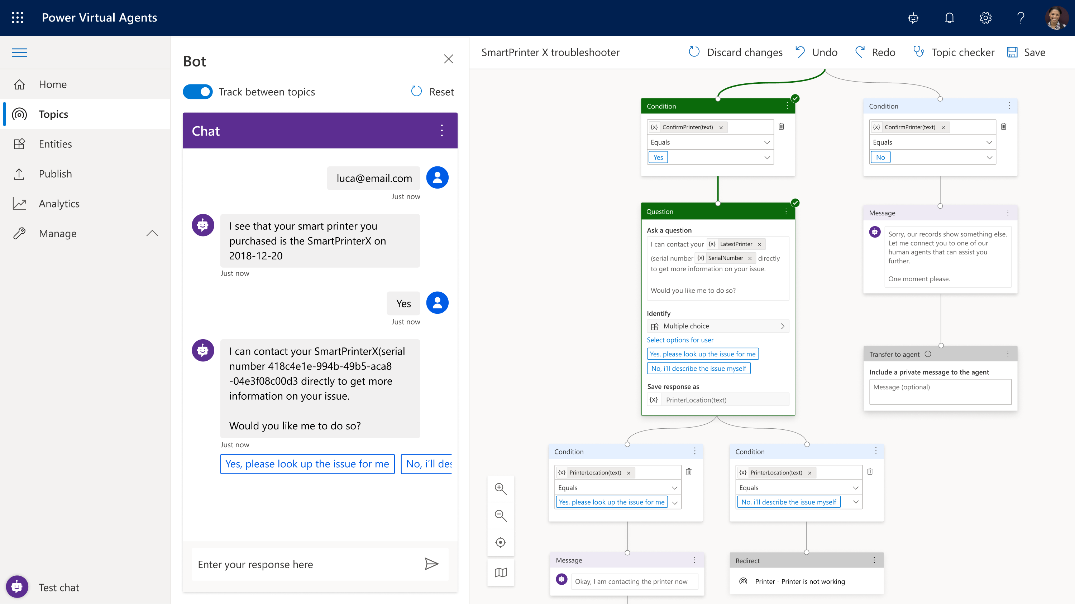
Transfer to a human agent
Configure and connect a bot to a human.
Hand-off to Dynamics 365 Omnichannel for Customer Service
Benefit from native integration to enable a hand-off from bot to live chat
Hand-off to generic live-chat provider
Extend hand-off capability to other providers

Slide 16
Personalize your customer experience
Learning 1: Extend your virtual agent with extended Power Automate capabilities
Learning 2: Personalize your customer experience with feature such as customer authentication

Slide 17
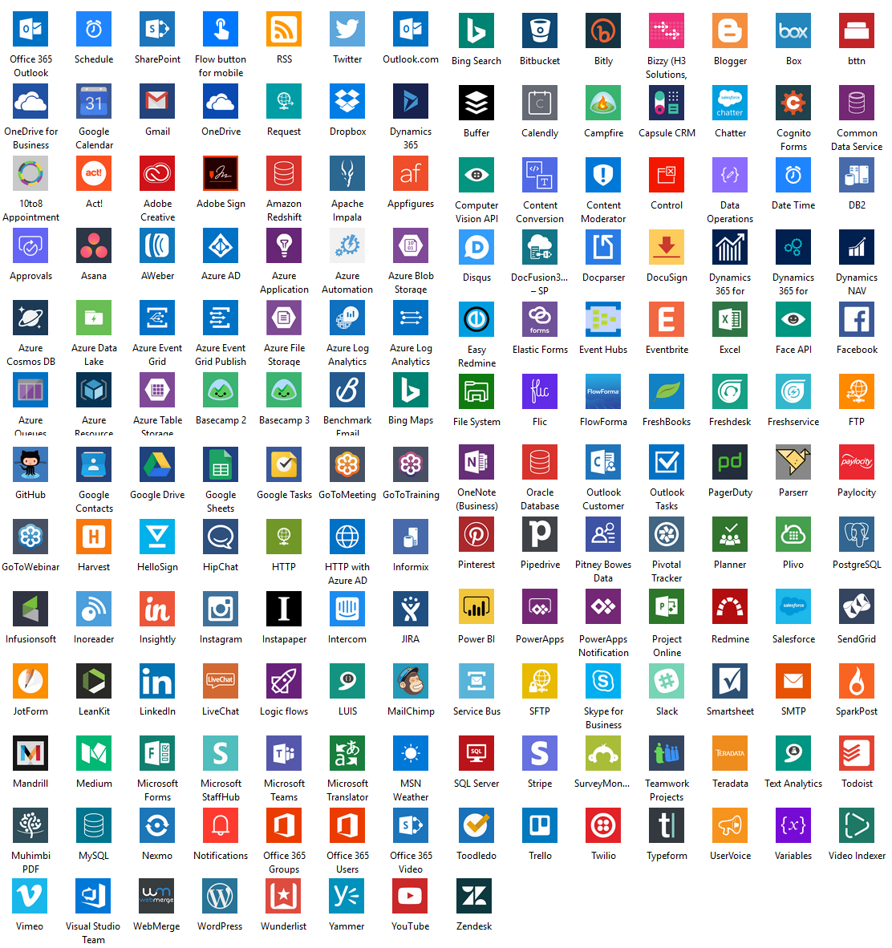
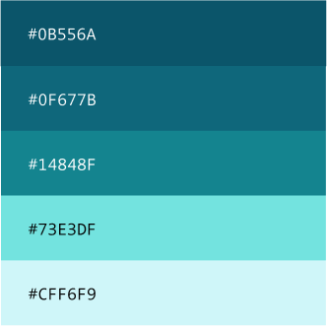
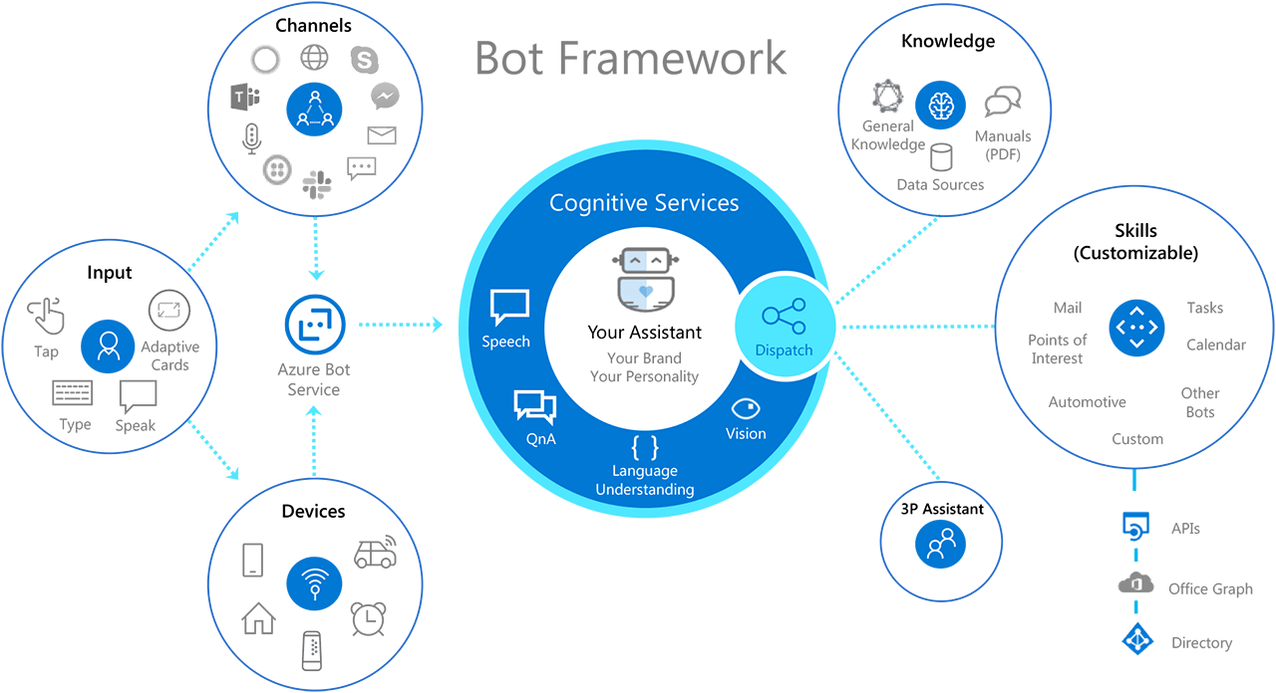
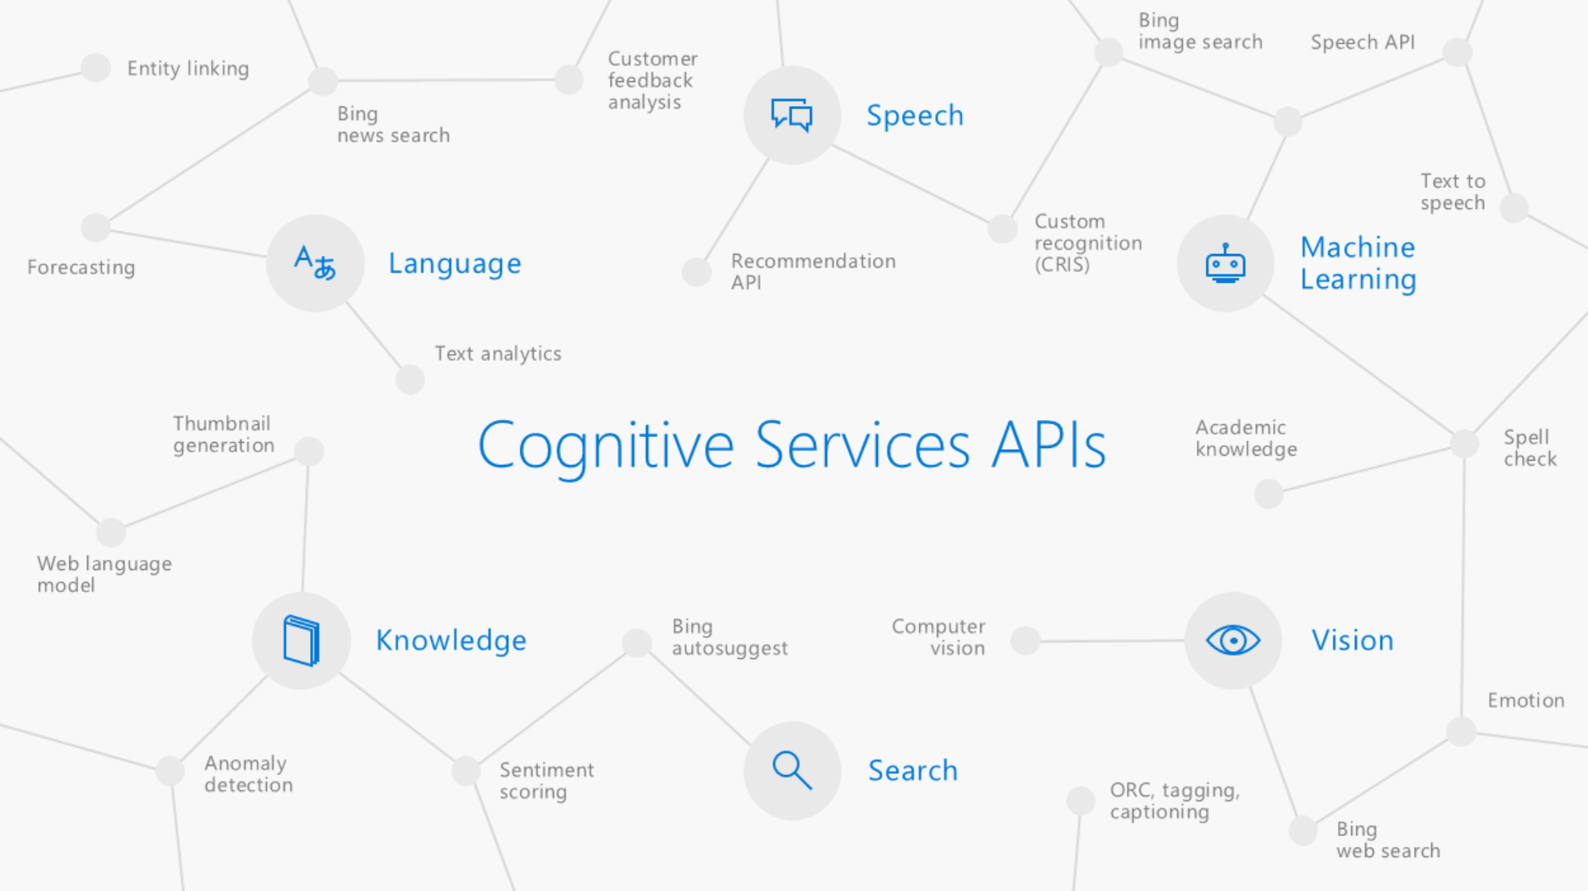
Built on Power Platform & Azure Bot Service
Power Virtual Agents
Power Platform Access to Flow, custom models through AI Builders and 100s of pre-built connectors
Azure Bot Service Easy, no-cliff access to the full power of the Azure Bot Framework
Azure Cognitive Services
Integrated with Azure Cognitive Services
Primary: Header, button links
Secondary: Text hyperlinks
Tertiary: Icon, UI details
Accent: Icon, Sparingly used
Accent: Icon, Sparingly used

Slide 18
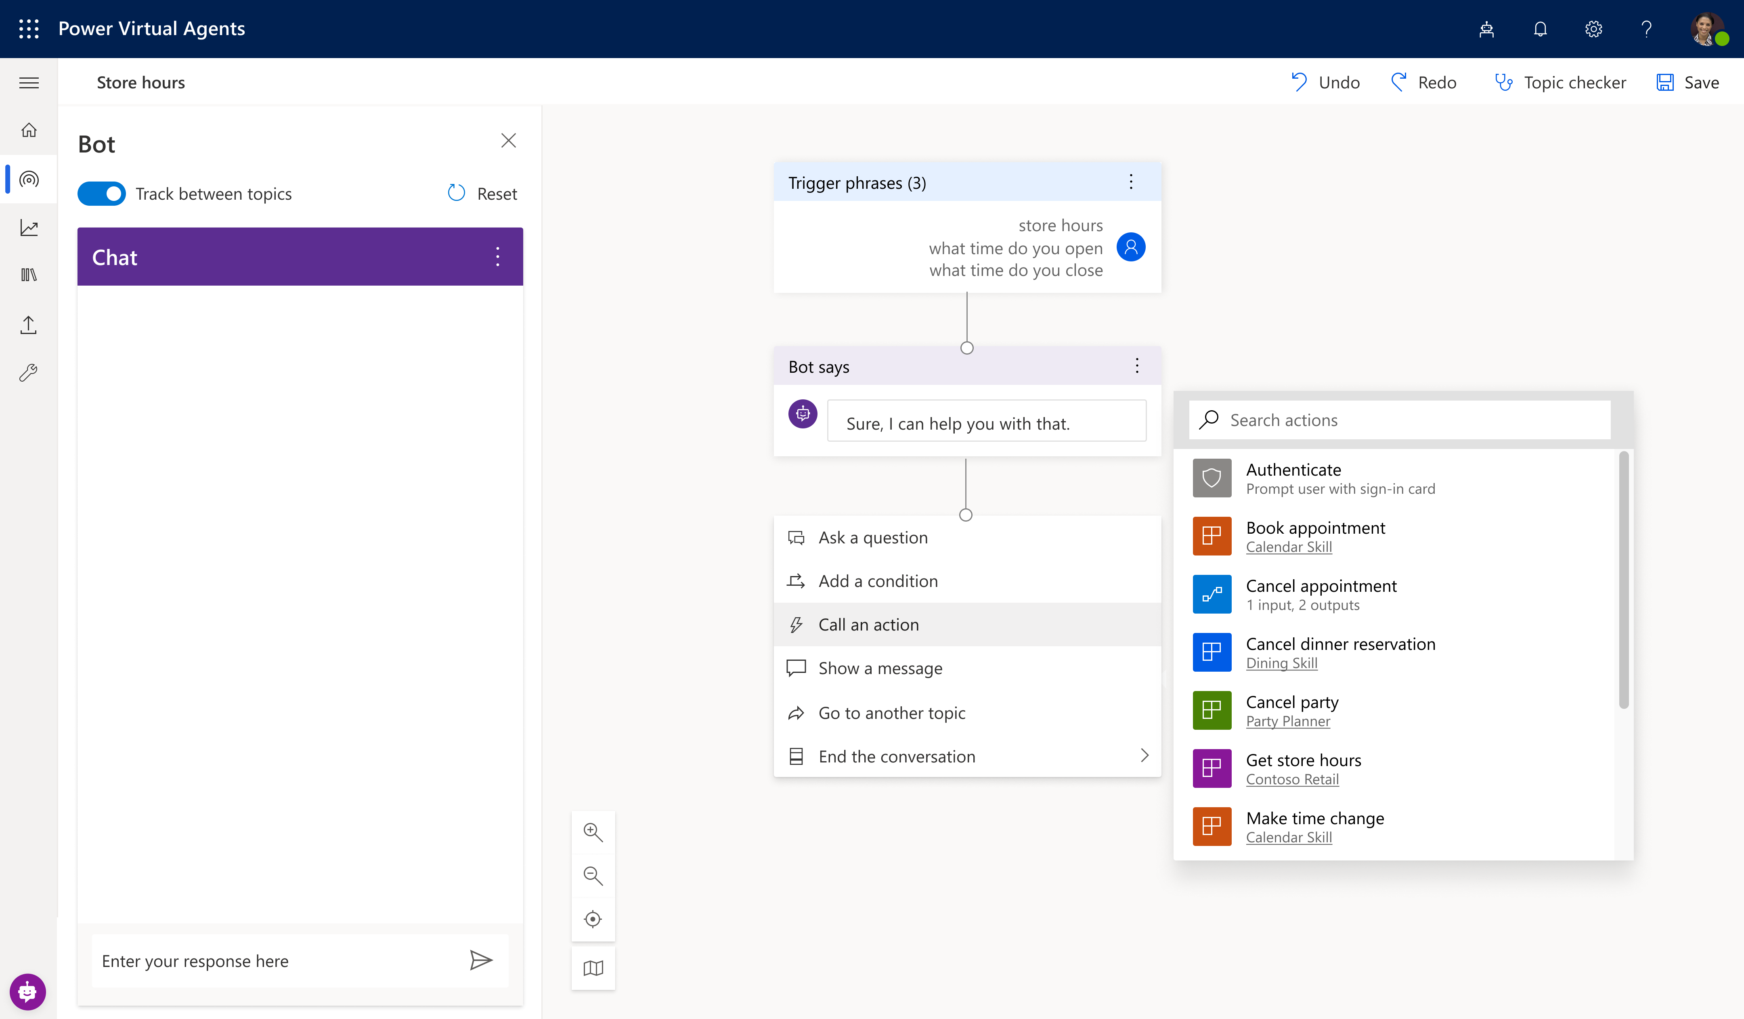
Extend your bot capabilities with Azure Bot Service
^{preview}
Microsoft Bot Framework Skills Support
Skills are reusable conversational dialogs that can be used to author scenarios using complex capabilities. Bot authors can convert any existing bot into a Skill and seamlessly trigger actions embedded in it through our no-code designer.

Slide 19

Demo
Create and deploy a Power Virtual Agents bot
Notes:
https://docs.microsoft.com/en-us/powerapps/maker/model-driven-apps/model-driven-app-overview
https://docs.microsoft.com/en-us/powerapps/maker/model-driven-apps/build-first-model-driven-app
https://docs.microsoft.com/en-us/powerapps/maker/model-driven-apps/model-driven-app-components

